Slide 1
MONGO DB
Aswin P P

Slide 2
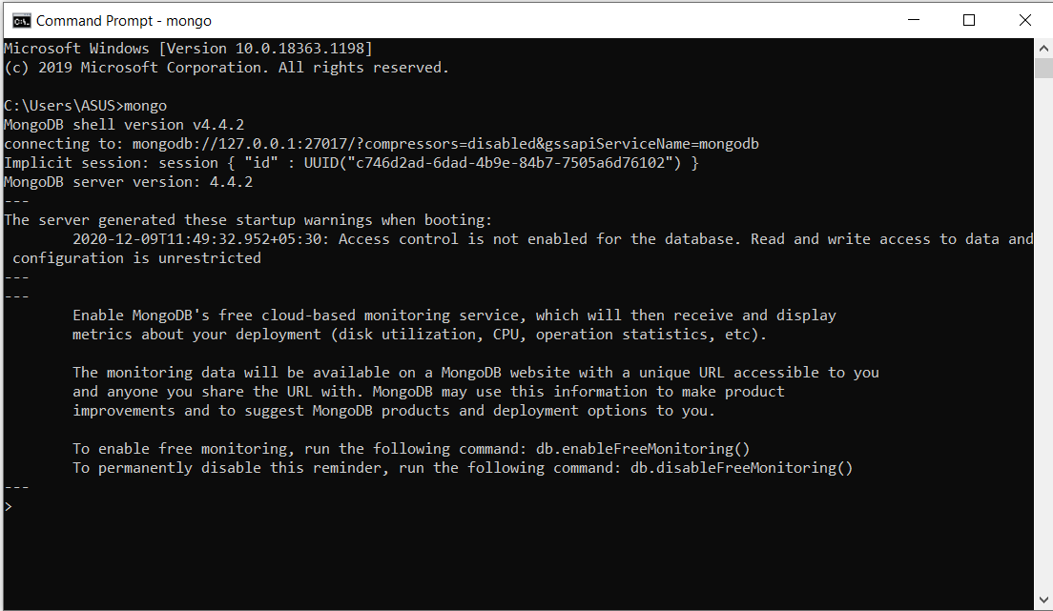
Run mongo db instance

Slide 3
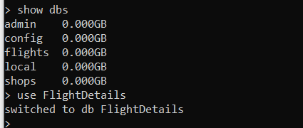
Create database

Slide 4
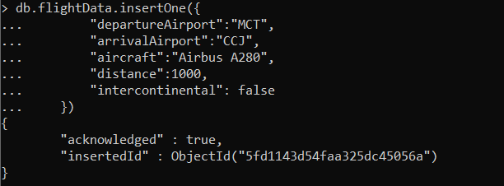
Inserting the document to the collection using insertOne()

Slide 5
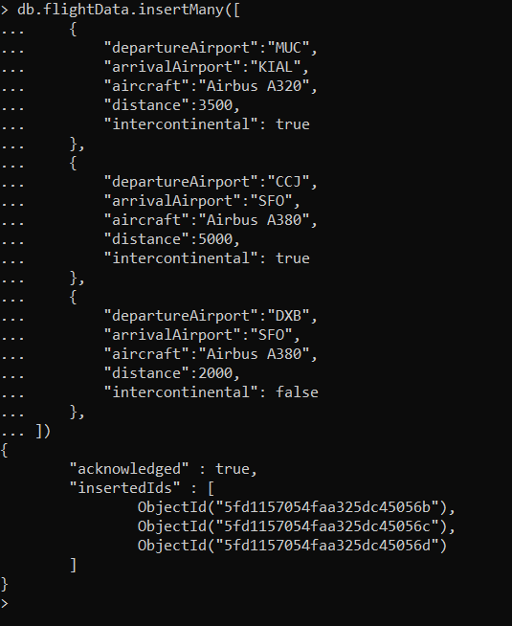
Inserting the document to the collection using insertMany()

Slide 6
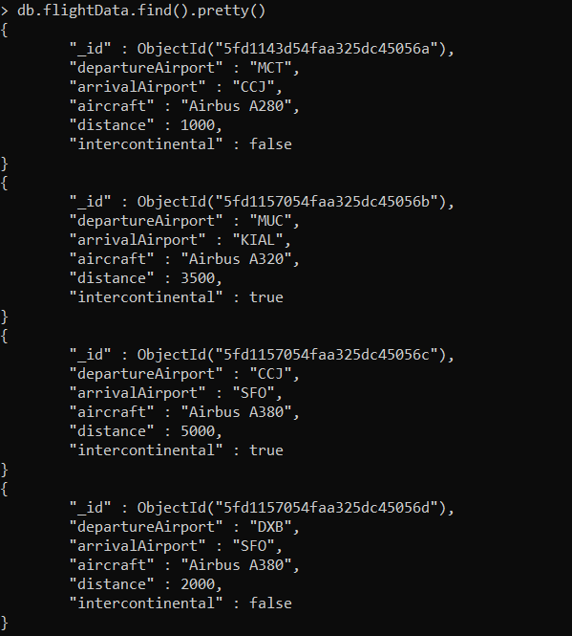
Reading the data

Slide 7
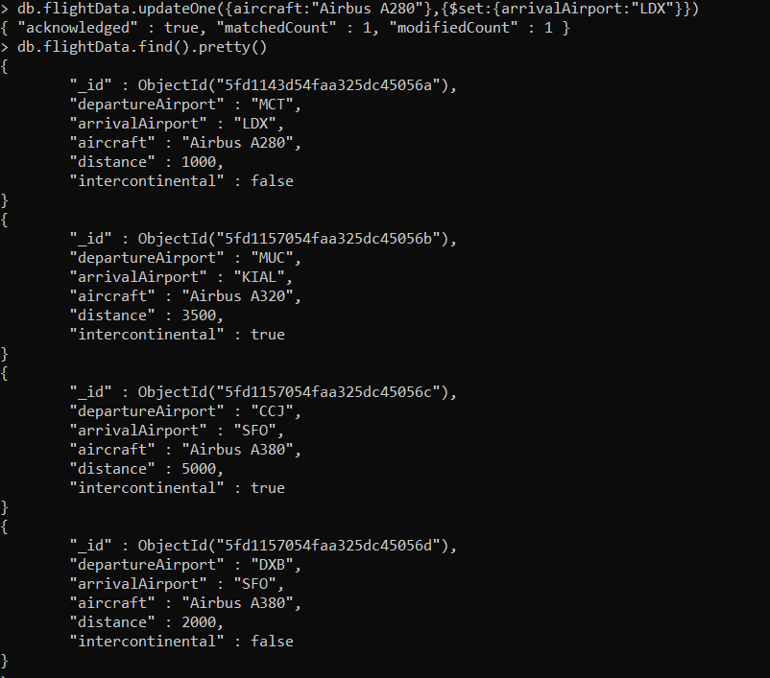
Updating the document with updateOne()

Slide 8
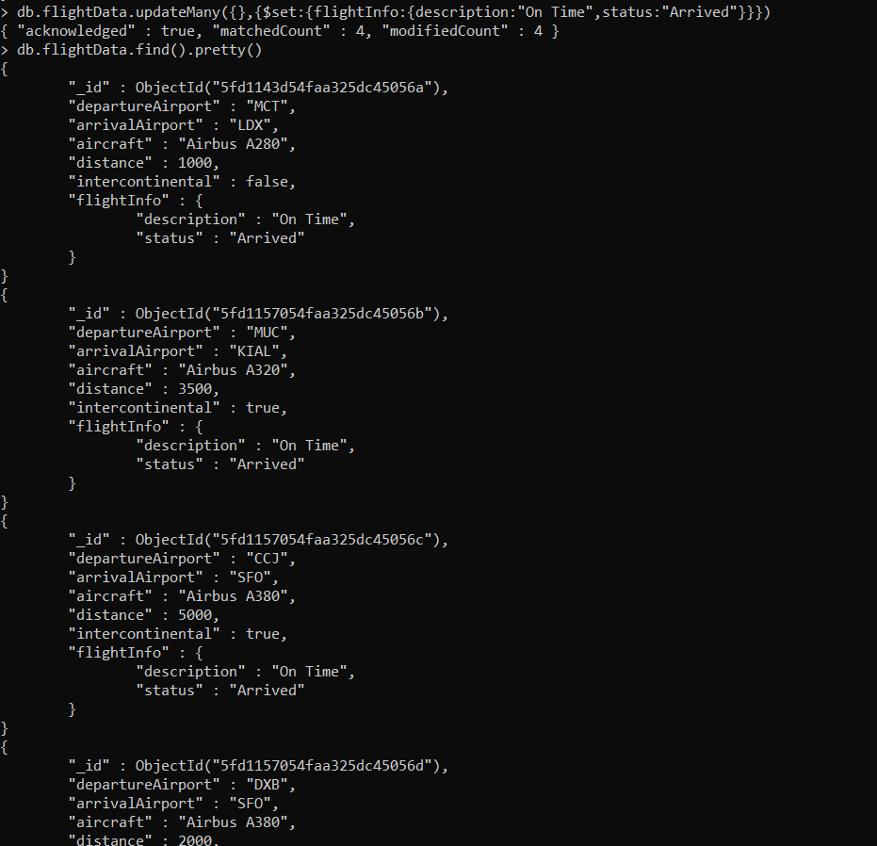
Updating the documents with updateMany()

Slide 9

Deleting the document with deleteOne()

Slide 10

Deleting the documents with deleteMany()

Slide 11
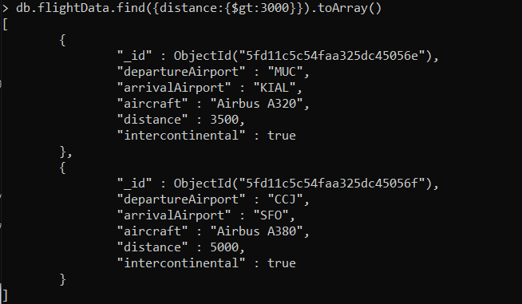
Displays details of document having distance greater than 3000

Slide 12
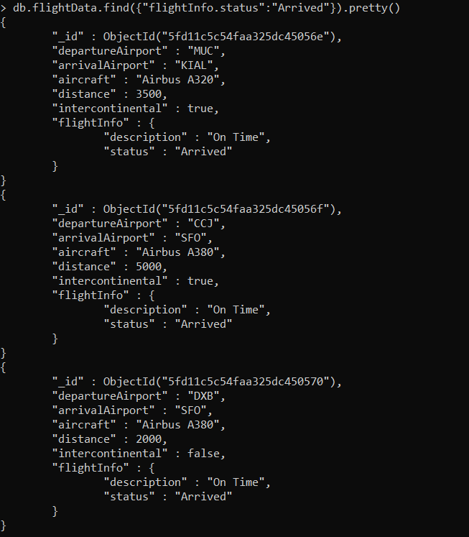
Returns data with status arrived

Slide 13
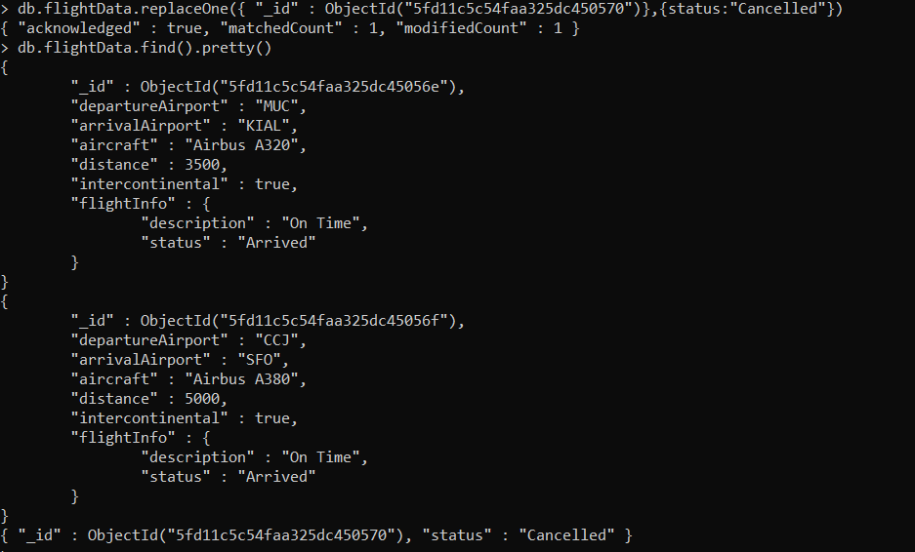
Replacing the document with replaceOne()

